Slide 1
Hands On Lab!
60 minutes

Slide 2
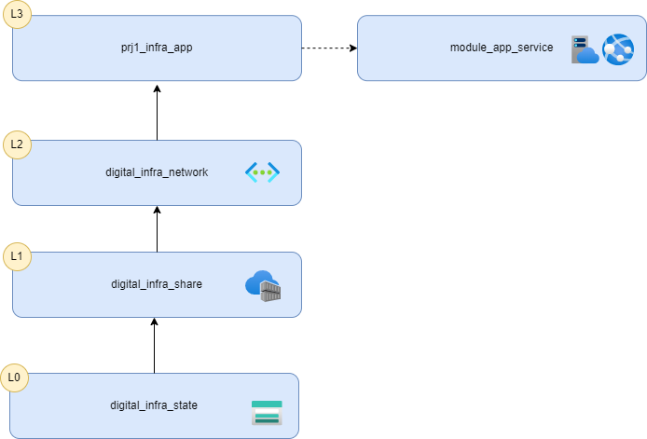
Migrate resource to Terraform
Let’s simulate the migration of a resource: Create an Azure Container Registry with Basic SKU in a resource group
Then, try one of these options to do the Terraform code:
Migrate ARM or Bicep template manually extracted to Terraform
Try to generate it with azdtfexport
https://github.com/Azure/aztfexport
Use Terraform import to generate it
https://developer.hashicorp.com/terraform/tutorials/state/state-import#define-import-block
Create a new folder called digital_infra_share and add this terraform code to it.

